Slide 1
job tracking application &system

Slide 2
OVERVIEW1.1
An applicant tracking system (ATS) is software that manages the recruiting and hiring process, including job postings and job applications. It organizes information about job seekers and makes it searchable. As its name implies, an ATS tracks candidates through the hiring process.
1.2 PURPOSE OF PROJECT
Job tracking software allows you to track the time you spend performing various tasks, including entire projects. Modern tracking systems also give you the option to measure and visualise your progress or calculate your billable hours using various hourly rates.

Slide 3

2. Problem Definition & Design Thinking
2.1 Empathy Map

Slide 4
2.2 Ideation & Brainstorming Map

Slide 5
Object name FIELD IN THE OBJECT ASSET RELATIONSHIP ASSET RELATIONSHIP
FIELD LABEL | DATA TYPE
RECRUITERS | TEXT
Job aplication | Master detail relationship
FIELD LABEL | DATA TYPE
RECRUITER | lookup
RECRUITER | Text area

Slide 6
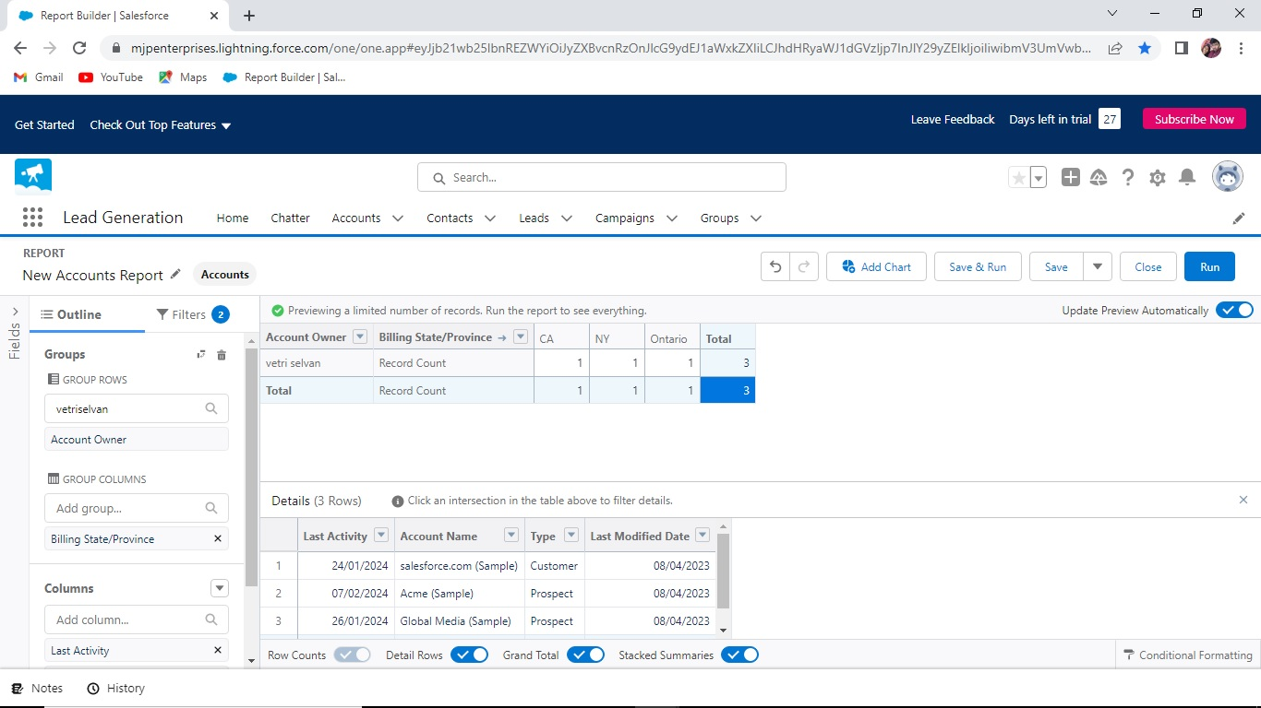
3.2 Activity & Screenshot

Slide 7
ADVANTAGES OF JOB TRACKING APPLICATION
Applicant tracking system advantages include enabling you to focus more on tasks that truly require your attention rather than spending manual resources on routine, mundane tasks. Good ATS can save almost 50% of your time by automating these routine tasks. In doing so, your processes get more efficient and faster.
DISADVANTAGE OF JOB TRACKING APPLICATION SYSTEM
Automatic elimination of every resume (even great ones) that the system can't read and interpret.
Missing out on potential great hires and great pipeline talent when resumes are eliminated.
Misread resumes in PDF format.
The inability to read most, if not all, graphics.

Slide 8
conclusion
THE purpose of the job tracking application system is used to determine the best candidate to fill a specific role within the company. Most companies provide such forms to anyone upon request, at which point it becomes the responsibility of the applicant to complete the form and return it to the employer for consideration.
future scope
An ATS creates opportunities to automate manual processes, increase visibility into the hiring cycle for the entire recruiting team, and increase opportunities for communication throughout the candidate journey. 78% of recruiters using an ATS report that it has improved the quality of the candidates they hire.

Slide 9
project was done by M.VETRISELVAN,S.VIGNESHKUMAR M.SUDHAKARAN

Slide 10
Trailhead Profile Public URL
Team Lead -https://trailblazer.me/id/vselvan5
TEAM MEMBER1-https://trailblazer.me/id/vigins69
TEAM MEMBER2-https://trailblazer.me/id/sudhm29

